Slide 1


City of Boston:
Remodeling and Unit Loss
Team B
Mid Semester presentation
Notes:
https://bostonu.zoom.us/j/5038077815#success

Slide 2




Team Breakdown
Jingbo Wang
Team rep
CS
2024
Zihan Li
Teammember
CS
2024
Jialong Ke
Teammember
CS
2024
Yuchen Cao
Teammember
CS
2024

Slide 3
Project Description
Our analysis and visualizations focus on improving how the City operates. This project will help the city understand trends that can be addressed at a strategic level. The focus is on how the influx of higher-income individuals, through buying and converting multiple-unit homes into larger, singular units, may be reducing the total number of housing units. Our project looks at the role remodeling and zoning conversions have played in the housing markets in Boston.

Slide 4
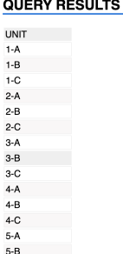
What we have done
Question Answered:
What communities are building more housing units?
Which ones are losing housing units?
Where are housing remodels and renovations happening?
Data Preliminary Analysis
Analyzed the changes in each type of unit undering 2009 - 2024
Analyzed the trend of permits in different regions for each year.
Checked out the new data dictionary and found some issues to analyze.

Slide 5
How many housing units are lost to remodels on average, each year?

Slide 6
Changes in Total Units from 2009 to 2024 on average each year:
Zip Code
02108 6.800000
02109 6.200000
02110 48.733333
02111 -1.466667
02113 7.266667
02114 -6.133333
02115 27.400000
02116 -637.733333
02118 -89.533333
02119 -9.400000
02120 0.866667
02121 7.066667
02122 23.533333
02124 5.266667
02125 34.066667
02126 -1.000000
02127 64.066667
Zip Code
02128 135.133333
02129 31.066667
02130 -15.333333
02131 39.333333
02132 -12.000000
02134 24.000000
02135 137.200000
02136 24.133333
02137 NaN
02146 NaN
02199 0.000000
02201 NaN
02210 64.466667
02215 39.533333
02445 NaN
02446 0.000000
02467 -13.266667

Slide 7
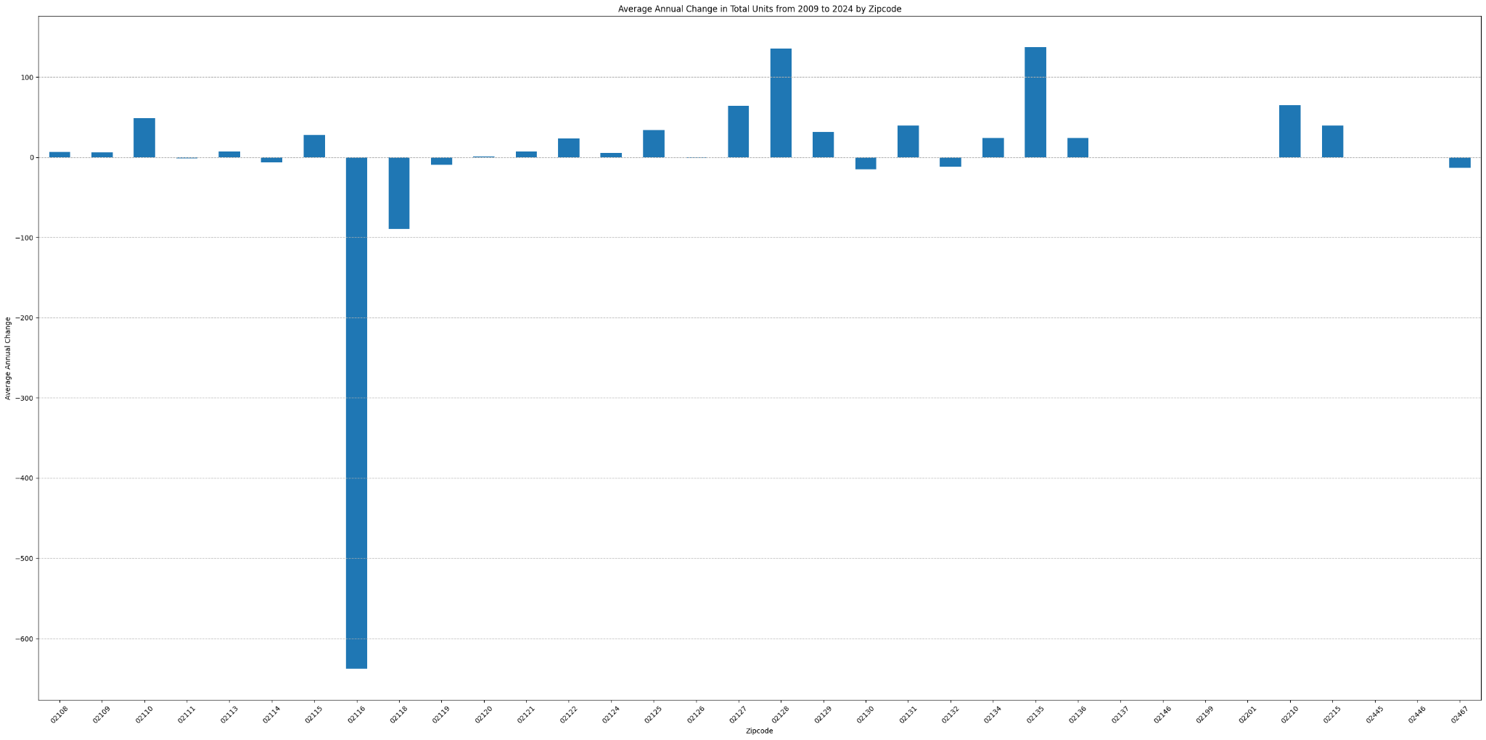
Changes in Total Units from 2009 to 2024 on average each year:

Slide 8
How has the remodeling taken place over different years?

Slide 9
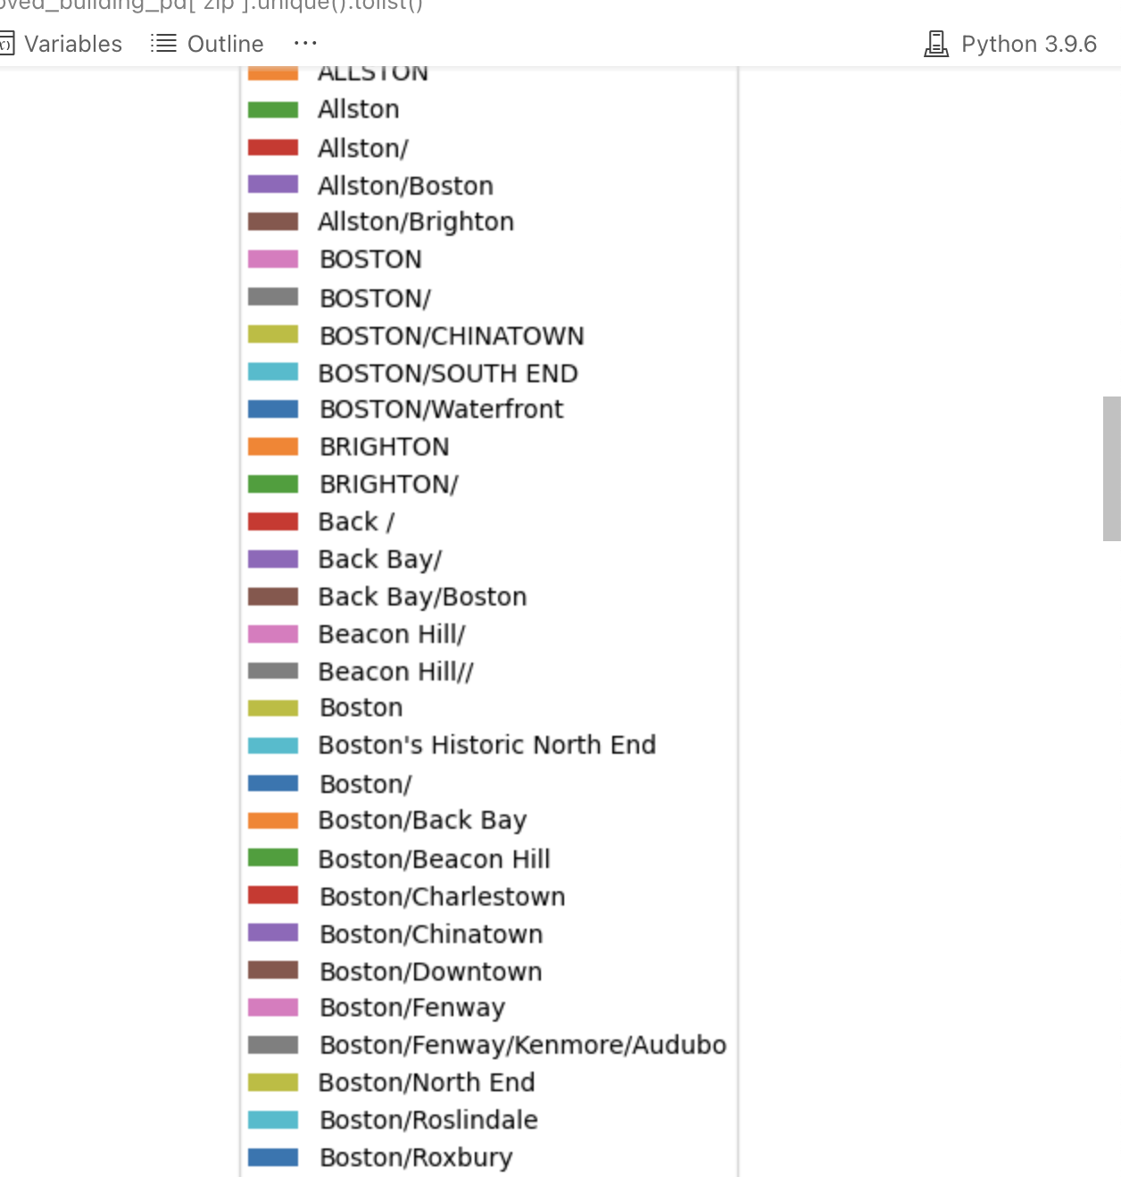
Comprehensive analysis report
It’s hard to directly use!

Slide 10
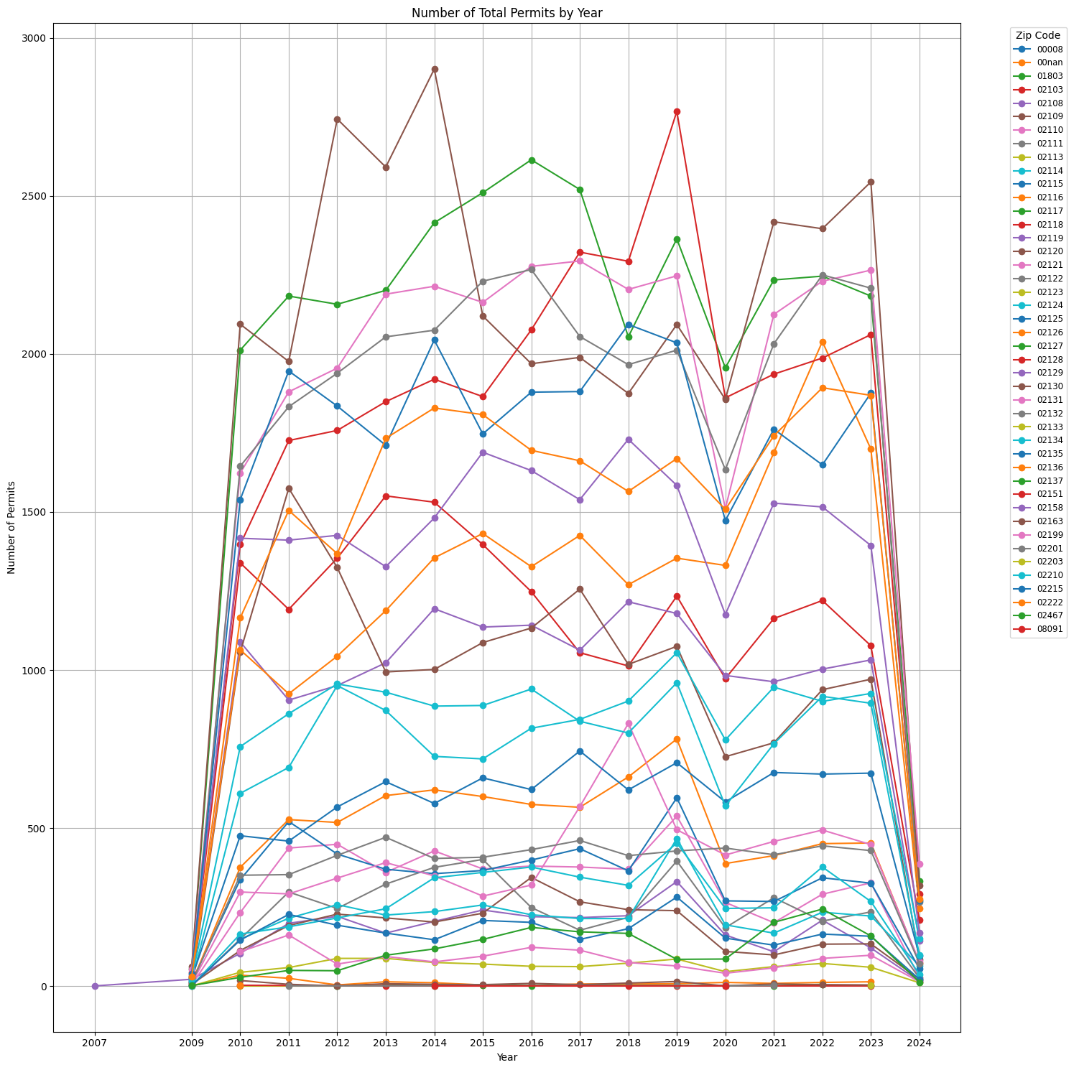
How many remodeling taken place in different area over different years
Each zip represents a different area in Boston
Number of permits
Year

Slide 11
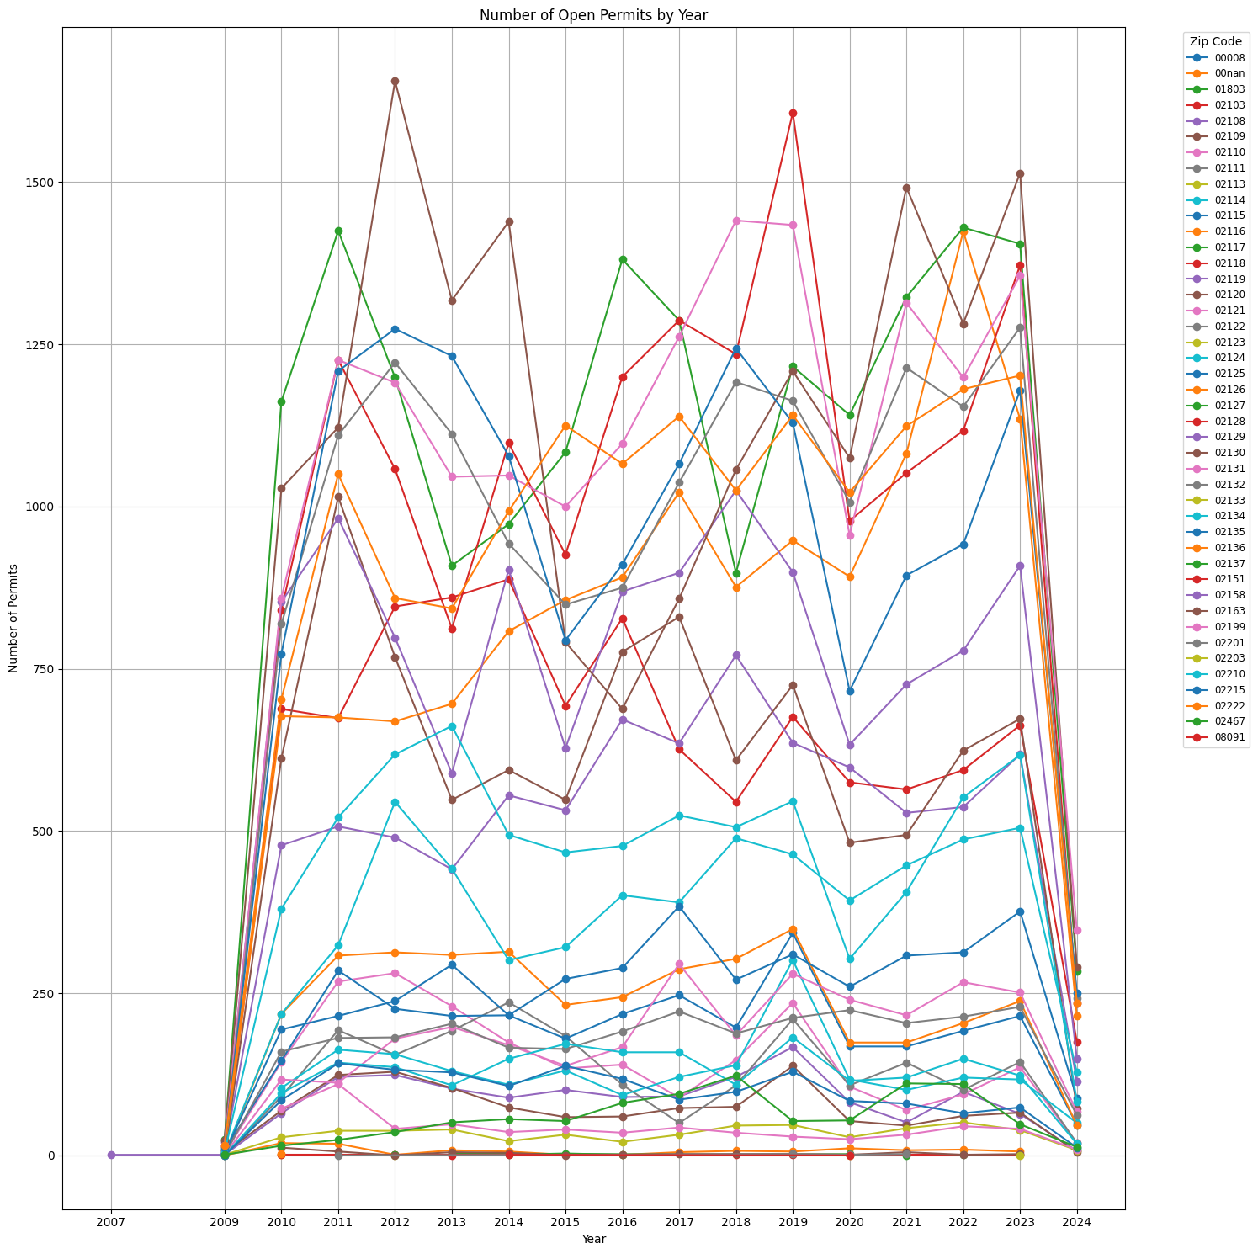
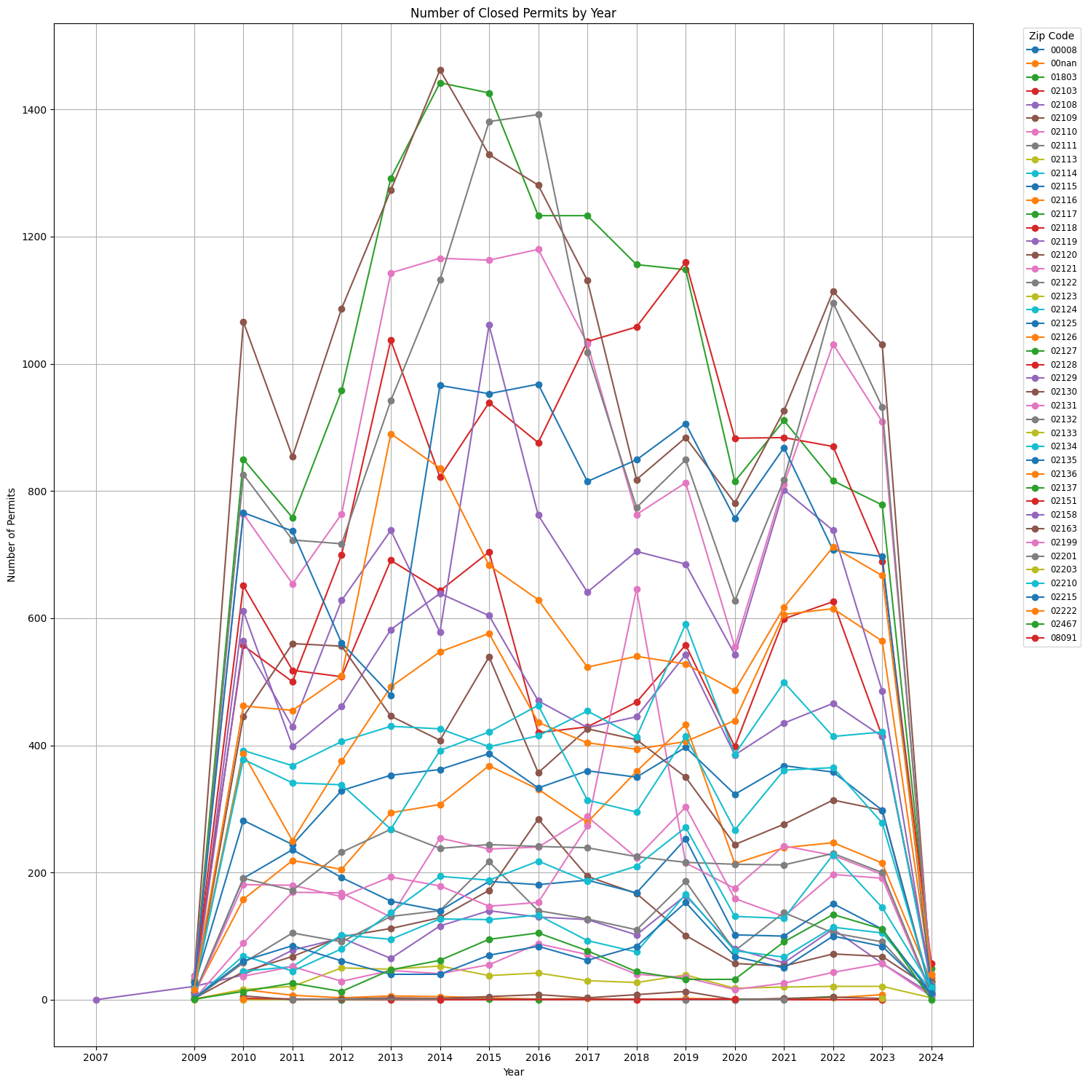
Open
Close

Slide 12
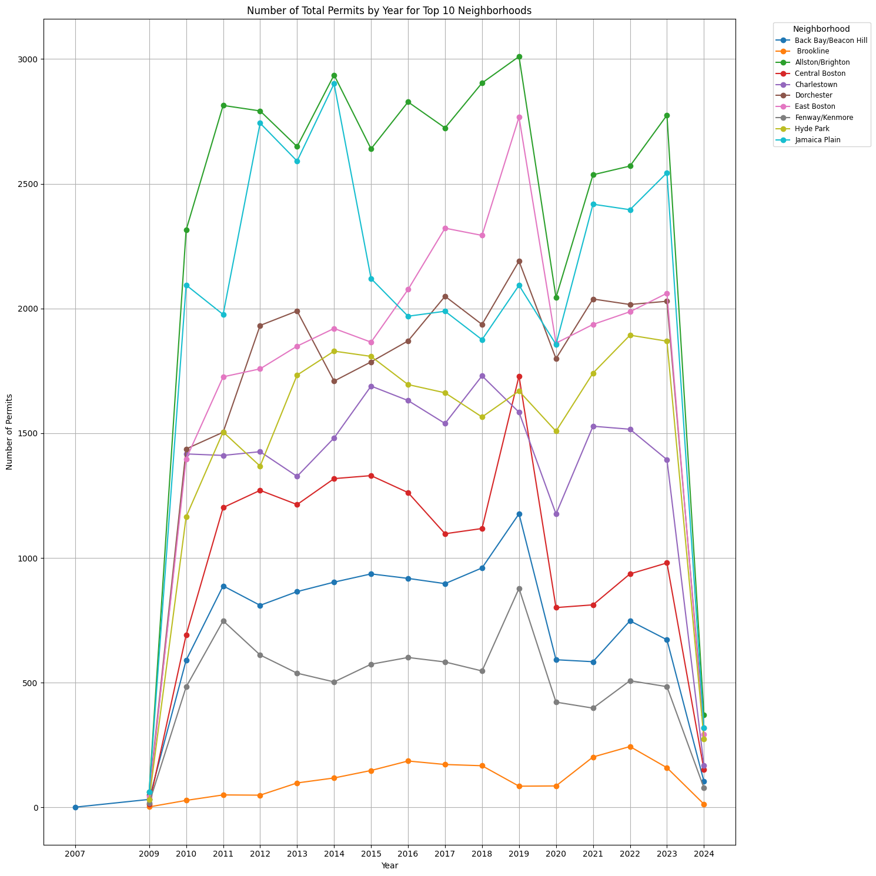
How many remodeling taken place in different area over different years
Top 10 neighborhoods
Number of permits
Year

Slide 13
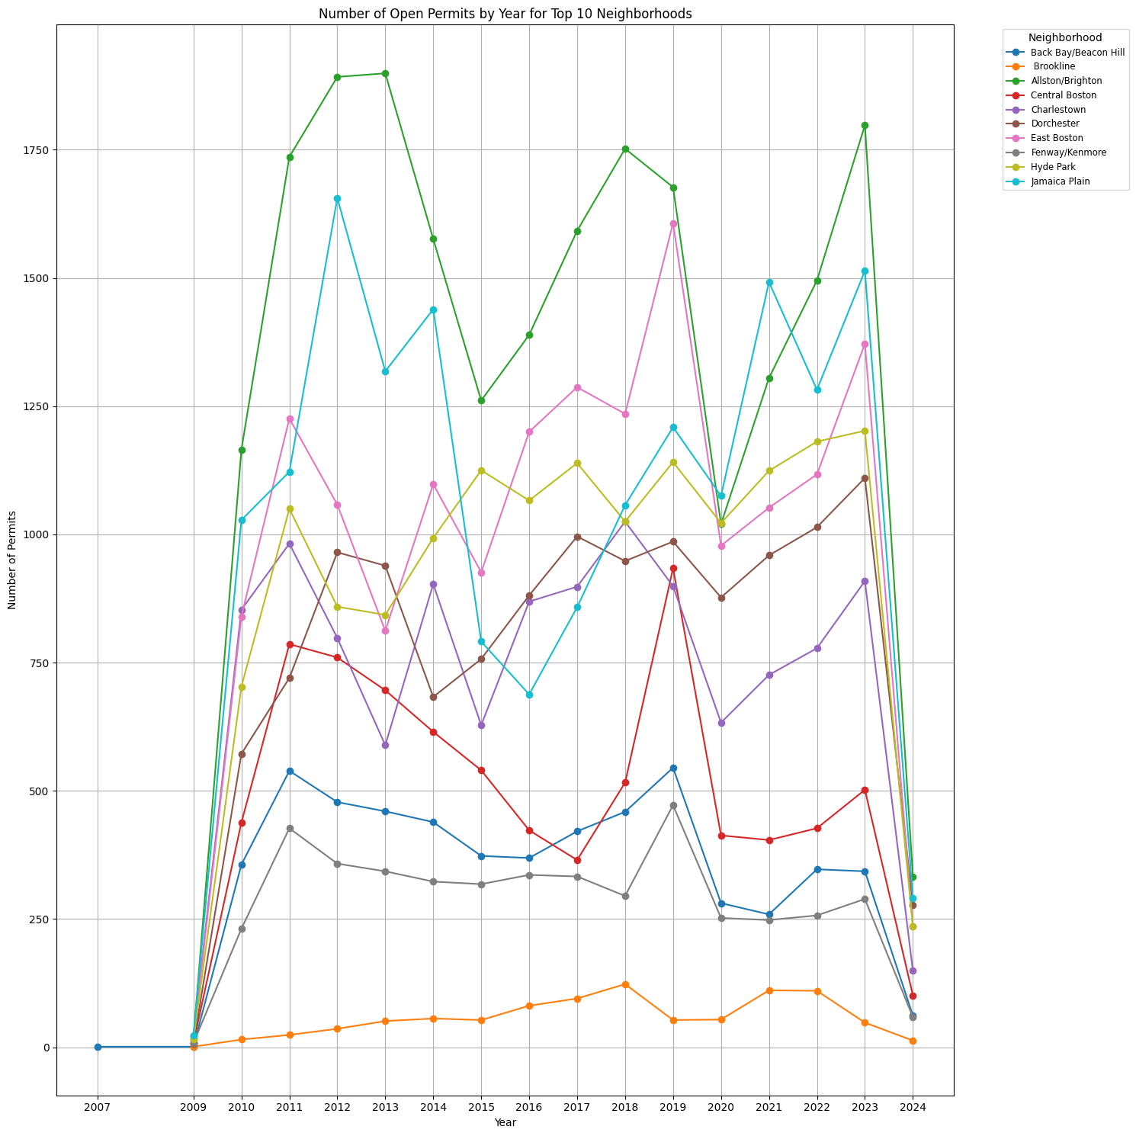
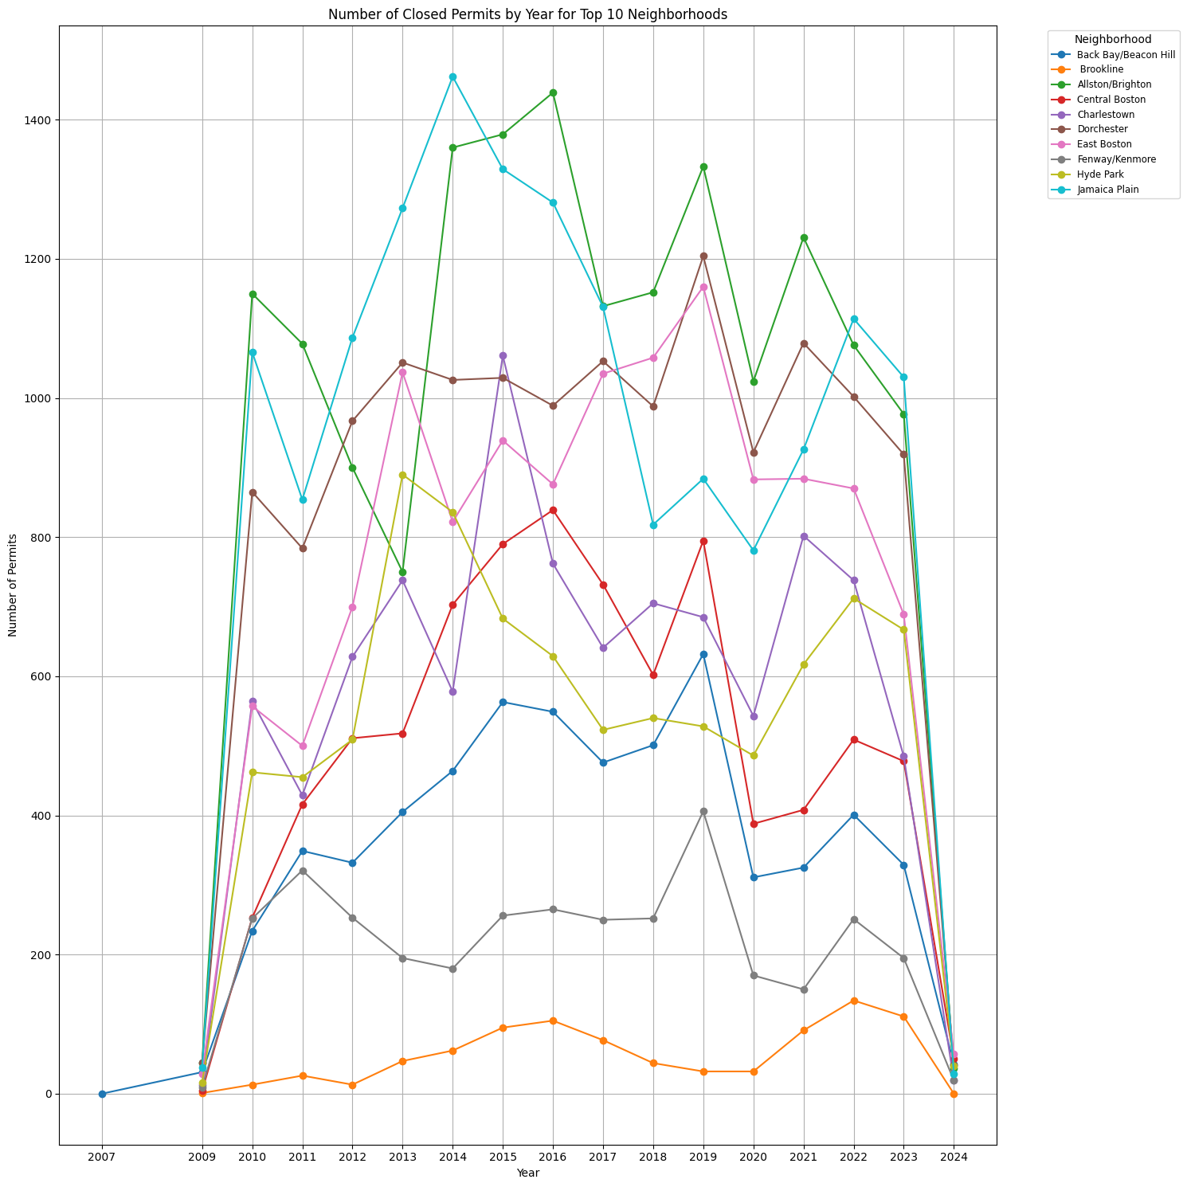
Open
Close

Slide 14
Tasks For next 2 weeks
Start writing draft of final report
Display the findings of the final report through visual representations
Analyze and research the datas and keys in the database.
Come up with more meaningful questions and solve them.
eg.
How has the area of a specific geographic location changed over different years?

Slide 15
Project Overall timeline
Project Kick off
Begin weekly scrum reports
Mid-Semester Report
Comprehensive analysis of project
February 28th
May 1st
January 29th
Now - April 8th
Early Insights Report
Preliminary analysis
Final Report
final report with visualizations, 3-4 key questions answered, and discussion of project findings.

Slide 16
Process OF working together
Meet for weekly client meetings
Discuss progress during weekly lab sessions
Team meet weekly every Friday to go over progress
Keeping track of and engaging with Trello board & Slack
Communicating with PM as needed

Slide 17
Tools and Documentation
Github: https://github.com/BU-Spark/ds-boston-remodeling/tree/team-b
Pandas Cheat Sheet: https://pandas.pydata.org/Pandas_Cheat_Sheet.pdf
Datasets: Property Assessment - Dataset - Analyze Boston Approved Building Permits - Dataset - Analyze Boston
Addresses (Sam database)
Meeting Notes: Weekly Team Meeting Notes
Project Description Doc: City of Boston: Remodeling and Unit Loss

Slide 18
Project Deliverables

Slide 19
Future steps

Slide 20
DEMO

Slide 21
Blockers

Slide 22
Takeaways
Notes:
Lavette: Will profile save if previously entered? Yes!
Linda: Options to access D7 App is great!!
Lucky Henry: How will it verify the address? Ask Dev team
How will it prove lives in district or not? Could match to voter file but only gets voters not constituents
Lavette: How will we remove people who harass the Councilor? Prevent white supremacists
Lucky Henry: will it keep out people who don’t live in D7? Could use Utility bill, License, Lease, Deed
Linda: What is the level of privacy? Need to make sure the data are secure so that residents/voters in D7 are not subject to harassment and/or negative activity. Lavette: How often will there will be a sweep of the data to make sure its → Tania: daily
Lavette: is it possible to give the Councilor’s office a notification when there is a negative sentiment text? Yes, but this would be future development.
Lavette: Are there stated norms stated on the App? NO, need to add
Pricilla: Add field for youth development
Lucky Henry: community building, mental health
Lavette: Antiracist ordinances
Louis: can we post a picture with a comment?
Can the Councilor post a picture in their post? THIS AN IMPORTANT!!
What resources could be posted under
Lavette: keep boxes highest level as possible and go to sub-topics Councilor: can you search easily for sub-topics that are missing within broader topic and can you post same request for sub-topics → can we add “what resources are you looking for?”
Question
Councilor: goal to create own software for constituent services → the
Councilor: need another section with button for constituent services →
Lavette: How will it be different from the 311 app? User friendly…
Linda: public transportation-refer to mbta for updates under resources for transportation
Request: add button for constituent services at top of resource page and replace “submit request or report” below
City Council not given resources to manage constituent relations
311 TOOL:
311 automate scraping of D7 forms
Consider using a two-way post
Policy request: make 311 APIs
Questions:
Is there an address list of residents for D7?
Confirm:
that Councilor has to approve posts
can the Councilor remove people who are approved/ logins
City:
make sure they will always know that there are multiple events scheduled on same time for D6

Slide 23
Overcome Blockers

Slide 24

Thank you!

